Slide 1
Front End Engineering-I Project
Team Details:
Harinder Singh Dhanoa, 2210990361
Harjot Kaur, 2210990362
Harjot Singh, 2210990363
Harkaran Singh, 2210990364
Faculty Coordinator:
DR.Ajay Kumar
:
Chitkara University Institute of Engineering and Technology,
Chitkara University, Punjab

Slide 2
Table of Contents
Introduction
Problem Statement
Technical Details
Key Features
Project Highlights
Bonus Feature(optional)
Conclusion
References/Links used

Slide 3
Introduction
The title of the project is “To-do List” designed by Harinder Singh Dhanoa, Harjot Kaur, Harjot Singh, Harkaran Singh of Group-23 of CSE department in Chitkara University.
It’s a list of tasks you need to complete or things that you want to do. People make a list of everything they need to do, ranked according to priority from the most critical task at the top to the least critical task at the bottom.A few of the features of a good to-do list application include:
Plan and execute simple actions.
Prioritize, manage, and reason about tasks.
Record notes, action items and ideas.
The Benefits of using a to do list:
Improves your memory: A to do list acts as an external memory aid. It’s only possible to hold a few pieces of information at one time. Keep a to do list and you’ll be able to keep track of everything, rather than just a few of the tasks you need to do. Your to do list will also reinforce the information, which makes it less likely you’re going to forget something.
Increases productivity: A to do list allows you to prioritize the tasks that are more important. This means you don’t waste time on tasks that don’t require your immediate attention. Your list will help you stay focused on the tasks that are the most important.
Helps with motivation: To do lists are a great motivational tool because you can use them to clarify your goals. You can divide your long-term goal into smaller, more achievable short-term goals and as you tick each one off your list, your confidence will increase.

Slide 4
Problem Statement
To-do lists contain user-interactive features with basic features like adding or removing tasks, highlighting dates, strikethrough features to indicate completion, and other text decoration components.
You can use JavaScript to build a web app that allows you to make to-do lists for routine tasks. For this project, you must be well-versed in HTML and CSS. JavaScript is the best choice for a to-do project since it allows users to design interactive coding lists where they can add, delete, and also group items.

Slide 5
Technical Details
❑ HTML HTML (HyperText Markup Language) is the most basic building block of the Web. It is used for describing structure of web pages and is also used to publish online documents, tables, lists, forms etc.
❑ CSS CSS (Cascading Style Sheets) is used for describes how HTML elements are to be displayed on screen, paper, or in other media.It can control the layout of multiple web pages all at once. External stylesheets are stored in CSS files.
❑ VISUAL STUDIO CODE
Visual Studio Code, also commonly referred to as VS Code, is a source-code editor made by Microsoft for Windows, Linux and macOS. Features include support for debugging, syntax highlighting, intelligent code completion, snippets, code refactoring, and embedded Git. Users can change the theme, keyboard shortcuts, preferences, and install extensions that add additional functionality.
NOTEPAD++
It is a free text editor for Microsoft Windows that provides additional features not found in the standard Windows text editor. Notepad++ is specially designed for editing Source Code. The "++" in the name is a reference to the increment operator in programming languages such as C, C++, Java, and JavaScript.

Slide 6
Key Features
The features of the to-do list applications include :
Viewing all the tasks in a user’s to-do list
Marking a task as completed
Deletion of tasks
Tasks are striked off when they are completed
Adding tasks to a user’s to-do list

Slide 7
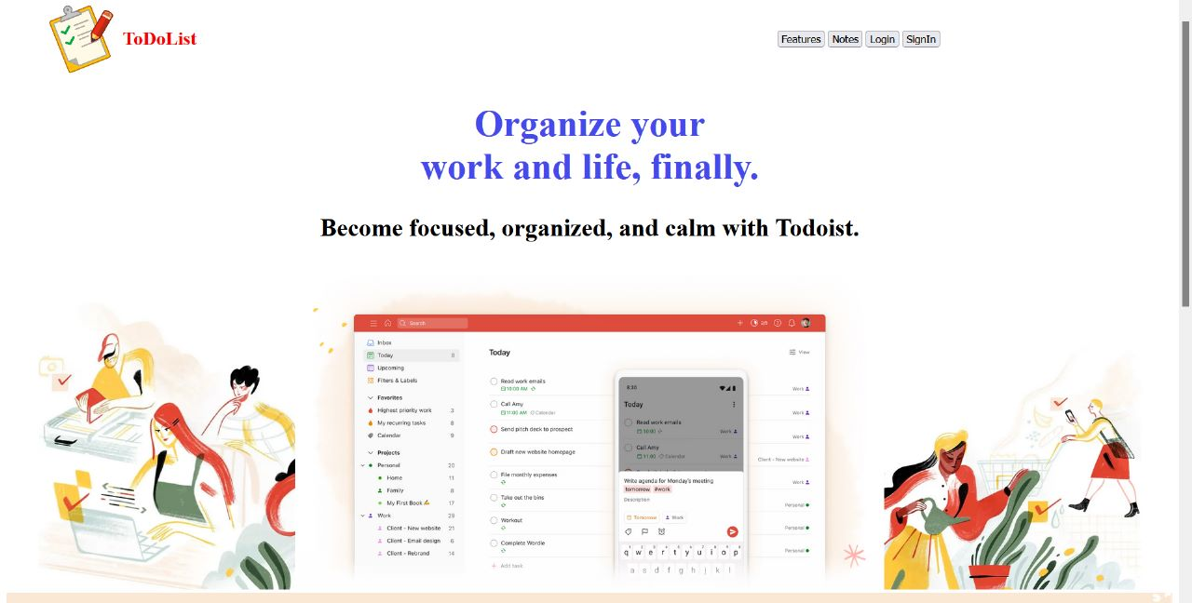
Project Highlights
Screenshots Of Running Project:

Slide 8
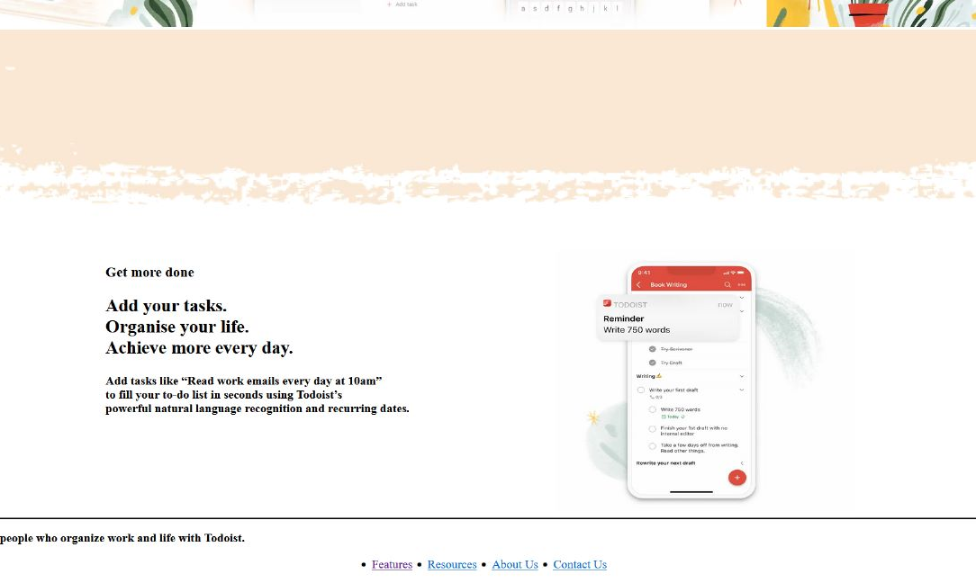

Slide 9
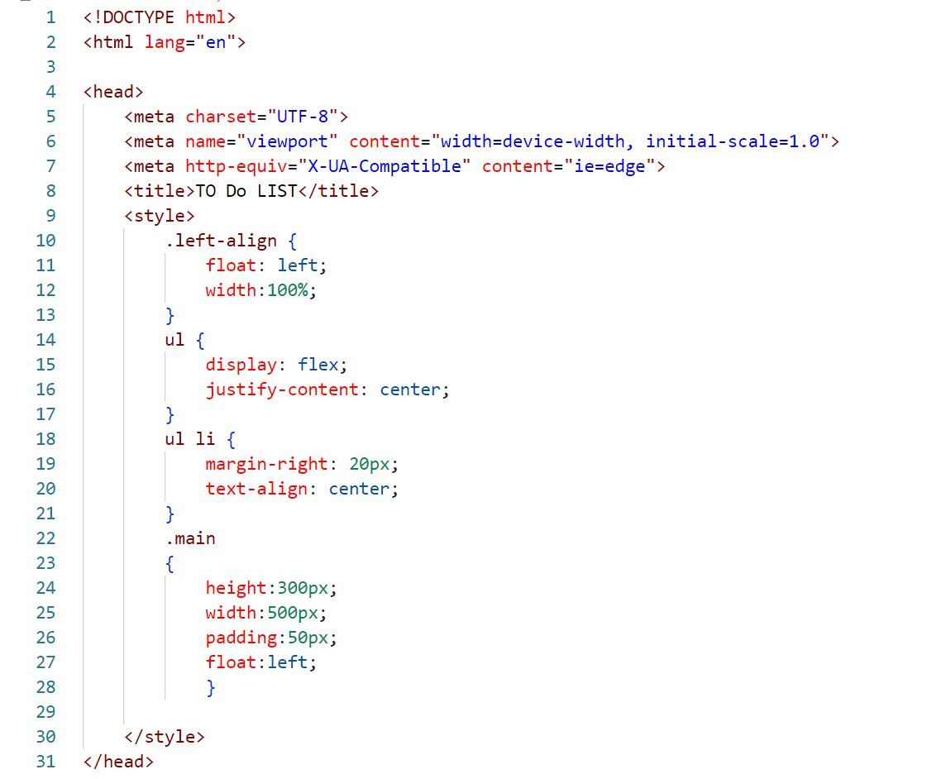
HTML Code Snippets:

Slide 10
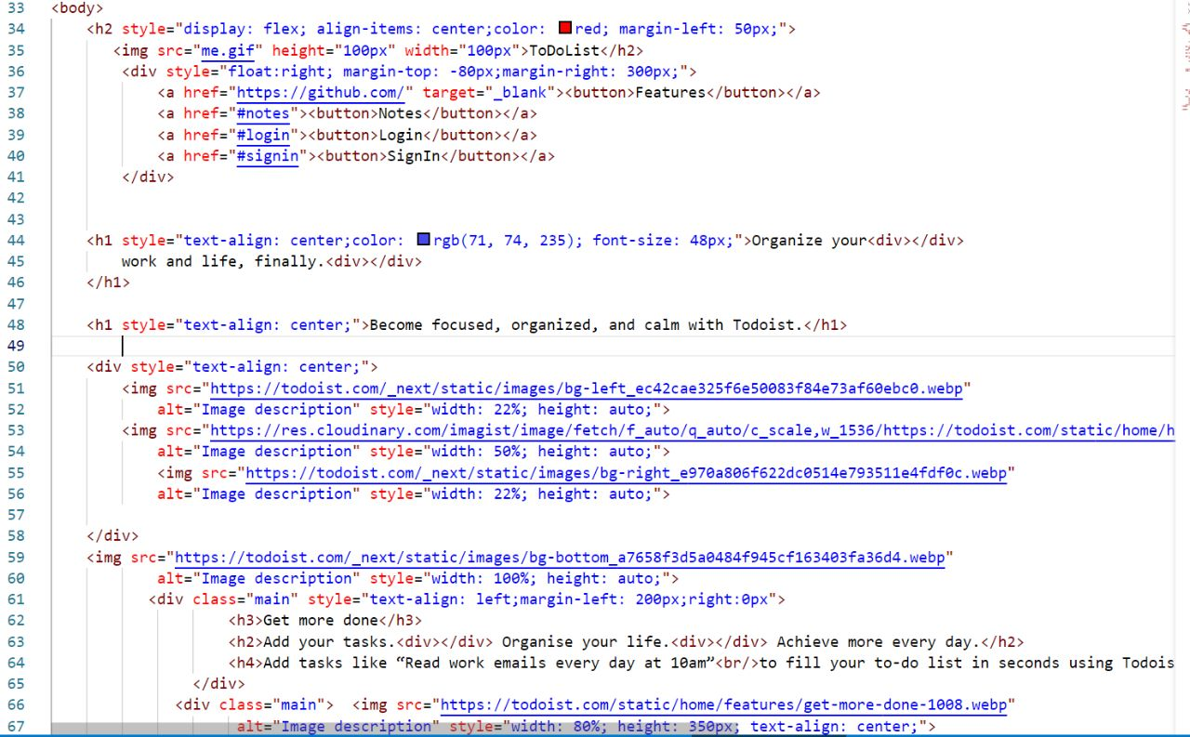

Slide 11
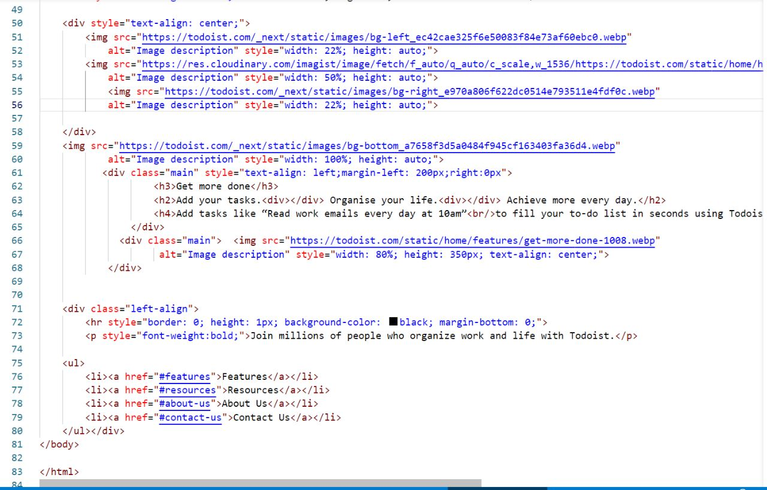

Slide 12
Bonus Feature
Improves website navigation
Time management optimisation
Internal linking

Slide 13
Conclusion
The to-do list developed for this project is meant to be a minimal, free and open source application that can help improve the productivity of a user without taking anything.
Moreover the future scope our project is , after adding javascript to our project , you can even add customisation to the to-do list , delete , add tasks as per your choice or requirement and also you can add prioritizations to the list , like according to your priority your list will be sorted.

Slide 14
References/Links used
o The Complete Reference HTML & CSS Fifth
Edition , Thomas A. Powell
o https://inclusive-components.design/a-todo-list/
o https://freefrontend.com/bootstrap-to-do-lists/

Slide 15


